Slide 1
FAOSD Programme User Instructions
Kong Cheong Tuck
FS Expert
20 – 21 October 2014

Slide 2
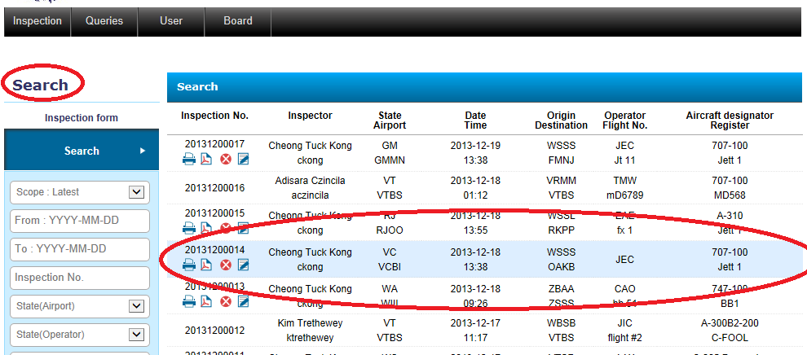
Inspection: History/Edit Functions

Slide 3
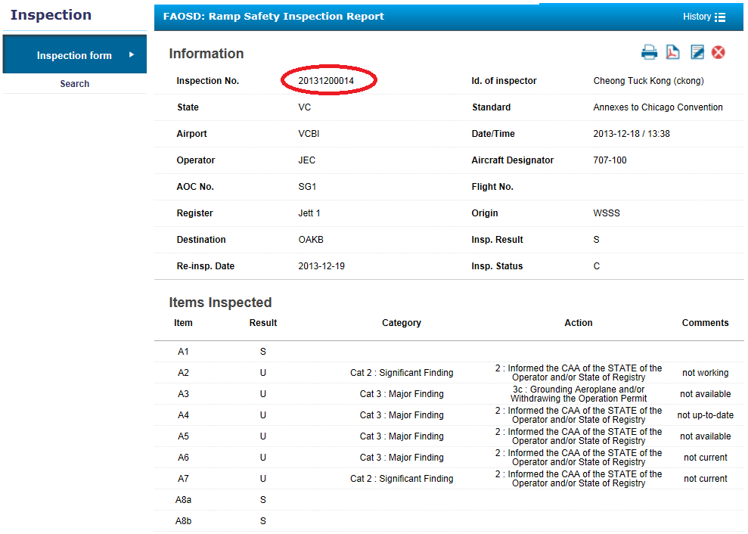
Inspection: History/Edit Functions

Slide 4
Inspection: History/Edit Functions
Make changes/amend your report

Slide 5
Symbols
Print Function
Save (to another location) Function
Delete Function
Display / Amend Function

Slide 6
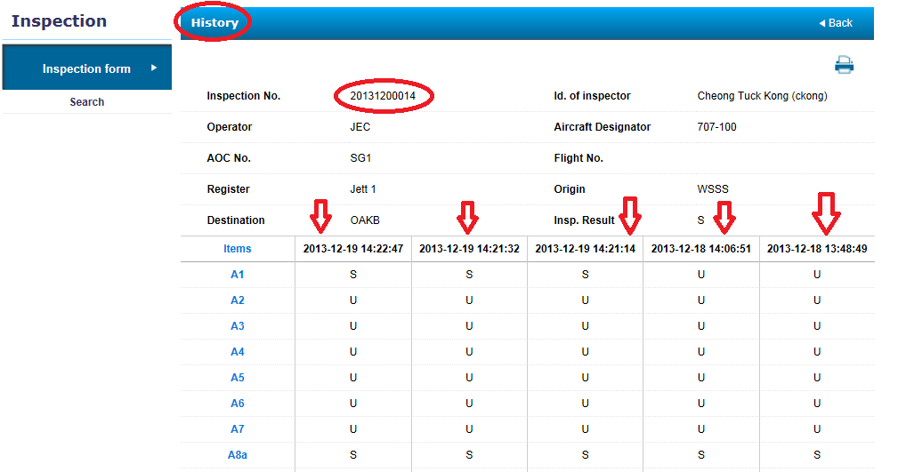
Inspection: History/Edit Functions

Slide 7
Inspection: Search
Thank You!
Q&A?

Slide 8
Exercise 4
Familiarise with the use of the History function
Familiarise with the functions available in the History function.
Make changes / corrections to your inspection reports.

